Slide 1
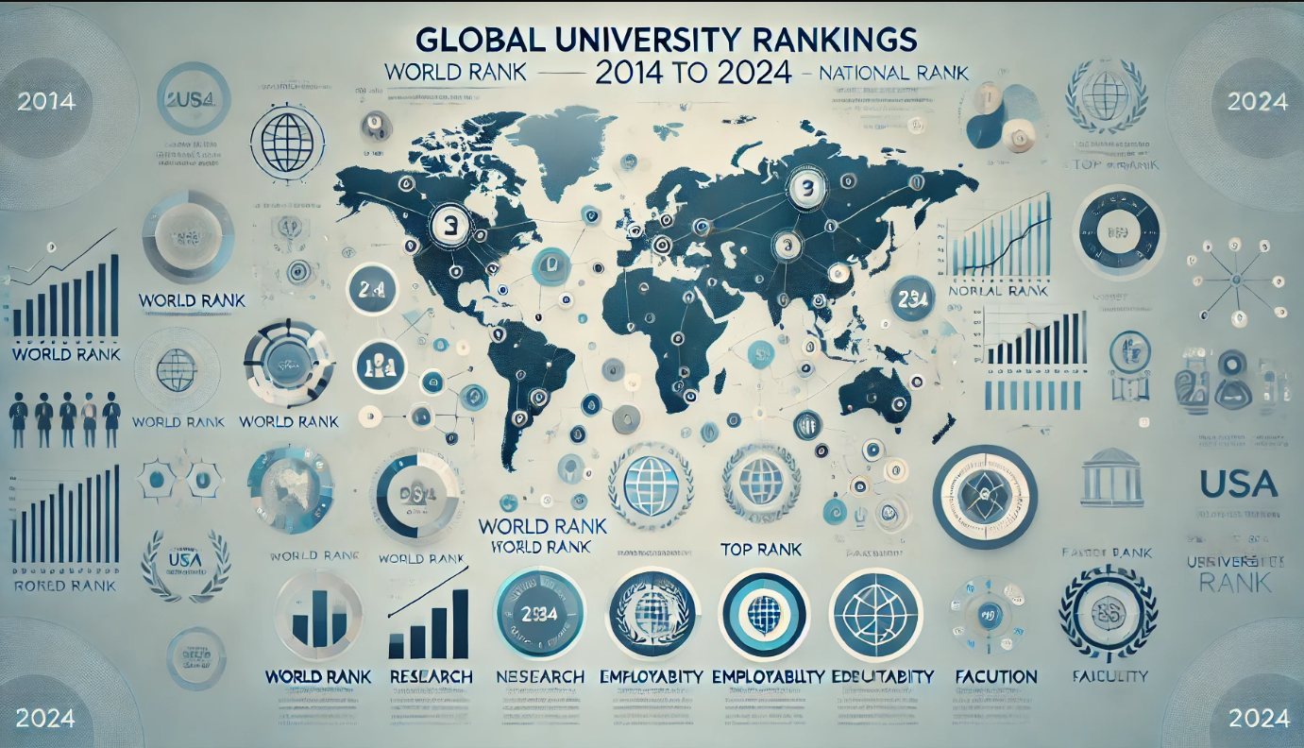

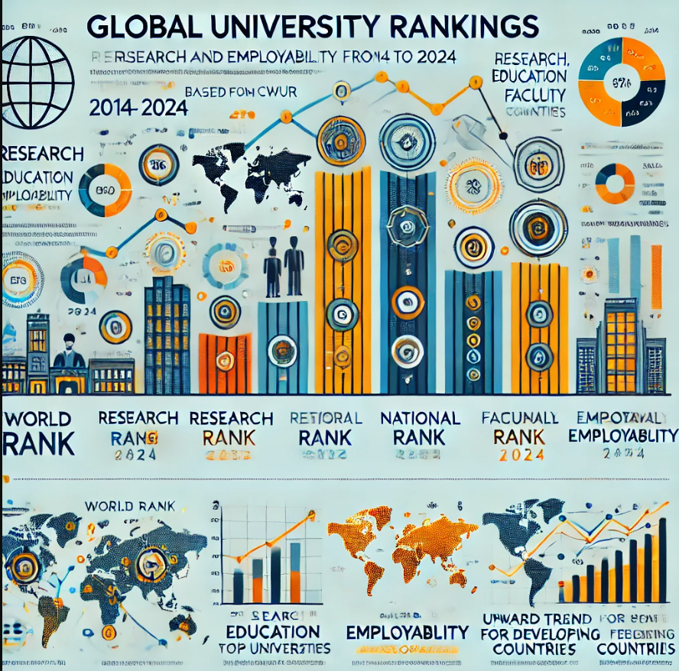
University Ranking Analysis (2014-2024)
Global University Trends:
A Decade of Rankings and Performance
Arman Ghaziaskari Naeini
November 2024

Slide 2

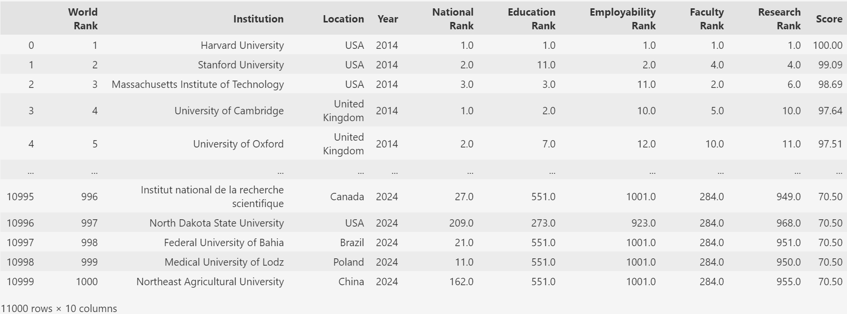
Data Source
Dataset from CWUR (Center for World University Rankings).
11,000 data points for universities worldwide.
Metrics included:
World Rank: Overall global rank.
National Rank: Position within country.
Research, Education, Employability, Faculty Rank.
Score (Not used in this Project)
Data Cleaning: Cleaning and Converted All rank data to numeric .
2014 - 2024

Slide 3
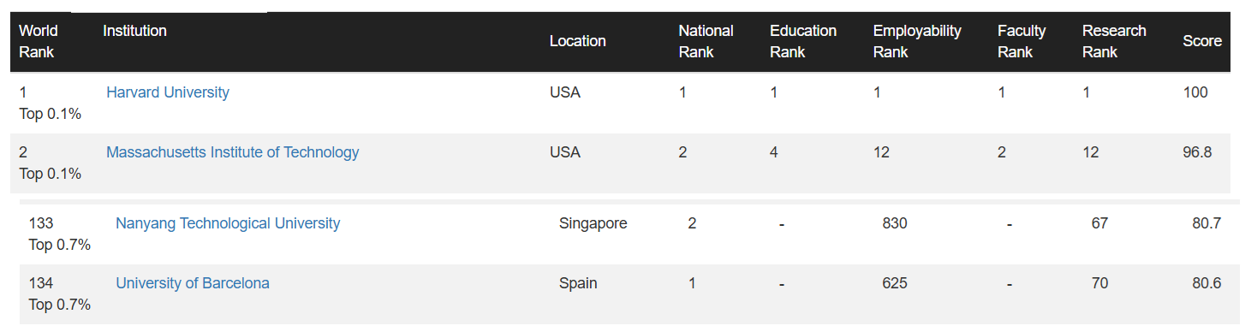
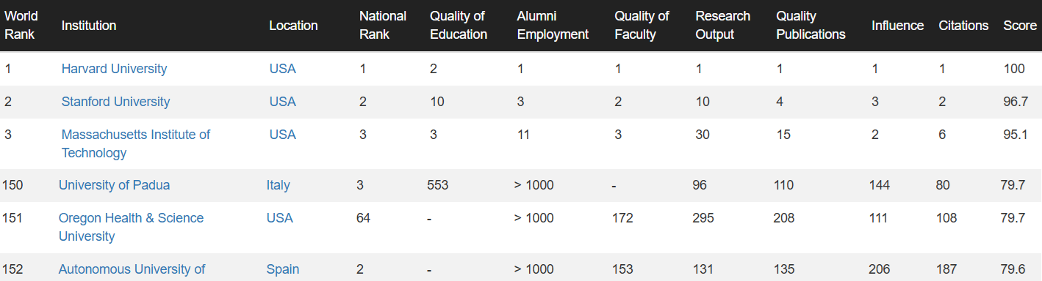
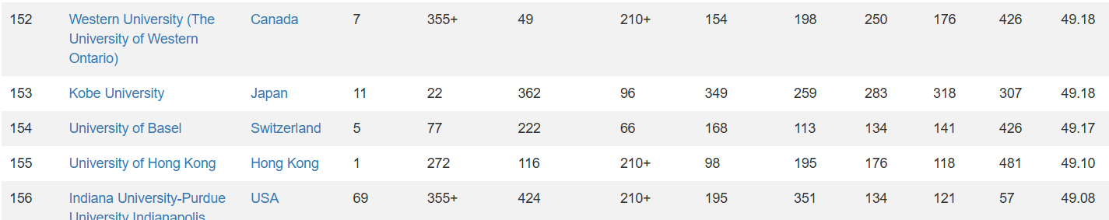
Problems in the data

Slide 4
Hypotheses
1- Research and employability ranks are the primary elements of global university rankings.
2- The rankings of the world’s top universities are relatively stable and exhibit minimal change over time.
3- Universities in developing countries, unlike those in developed countries, are showing an upward trend in global rankings.

Slide 5
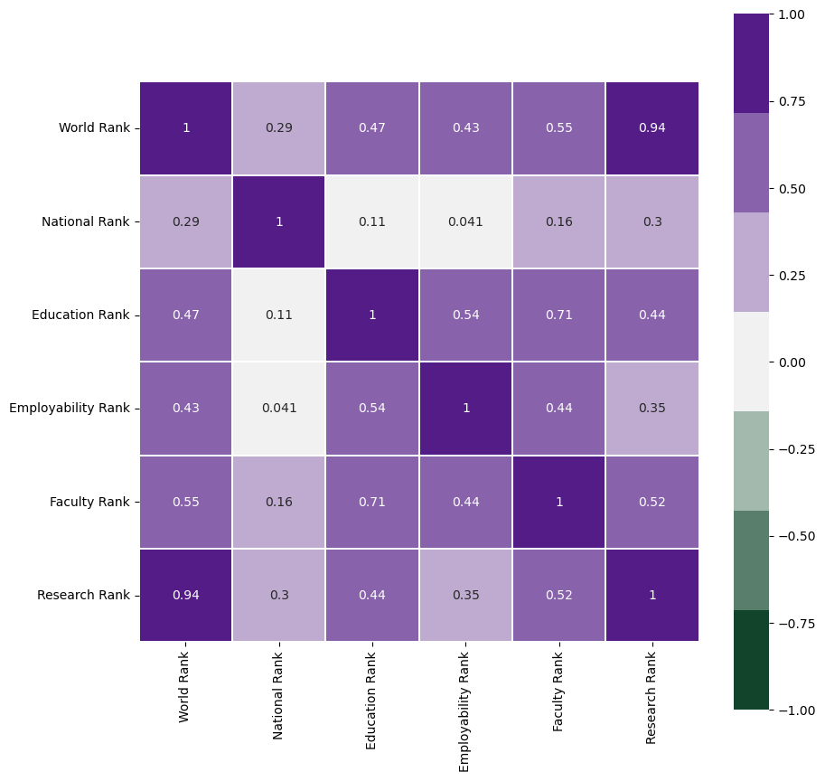
Research Rank and then Faculty Rank are key drivers of World Rank. Education Rank and Employability Rank moderately influencing other metrics. National Rank has weak correlations with other variables.

Slide 6
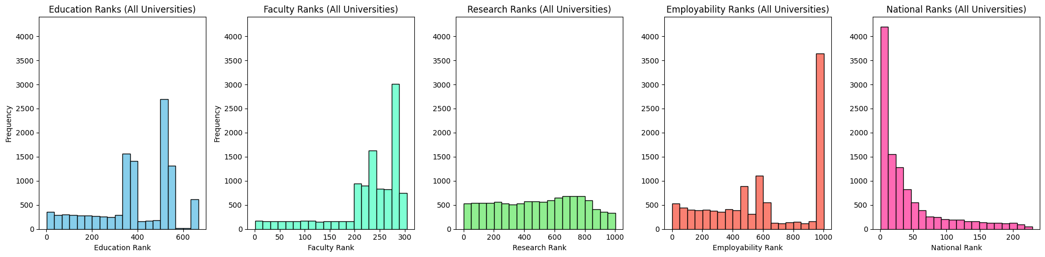
Top Universities Lead in Faculty, Education, and Research: Leading institutions rank high in these areas.
Employability Shows Graduate Success Variability: Employability ranks differ across top universities.
Top-Ranked Universities Lead Nationally: Many are within their country's top 50.
Research and Faculty Influence High Rankings: Strong research and faculty boost global positions.

Slide 7
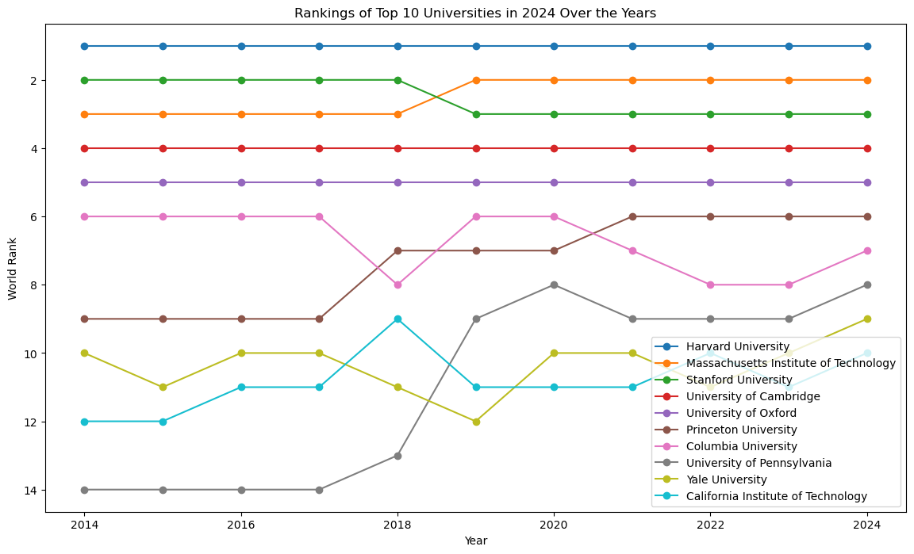
Top 5 universities stayed stable in rankings from 2014 to 2024.
Rankings for universities in 6th to 10th place shifted between 6th and 14th.
Overall, top university rankings have stayed mostly steady over the years.

Slide 8
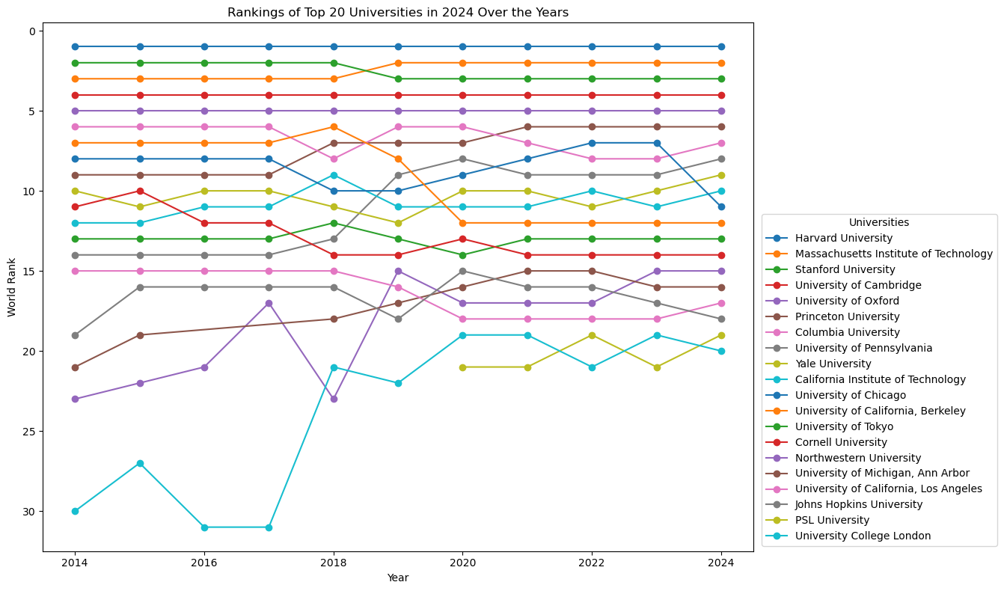
Top 20 Universities Analysis:
Minimal changes in the top 5 positions over the years
Significant shifts between the 5th and 20th positions
Some universities have moved from the 30th to the top 20
Notable Inclusion:
PSL University of France entered the top rankings post-2020
Formally established as a university in 2019

Slide 9
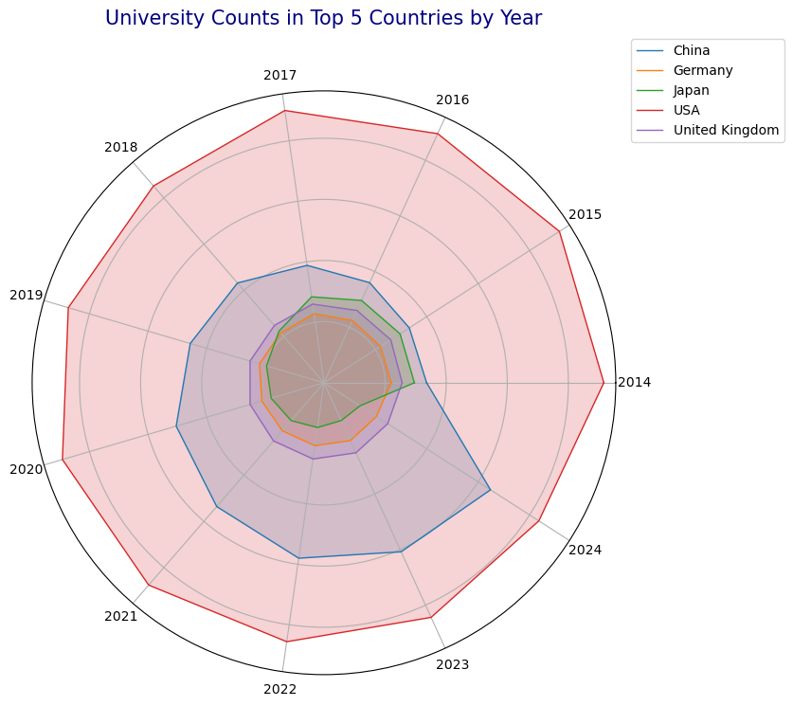
The USA and China dominate the spider plot with the largest areas. China has grown quickly in recent years, expanding outward on the plot. Japan, Germany, and the UK have smaller, stable areas, showing steady representation. The plot highlights the USA's lead in rankings, with China closing the gap quickly.
Top 1000 University Counts in Top 5 Countries Over Year

Slide 10
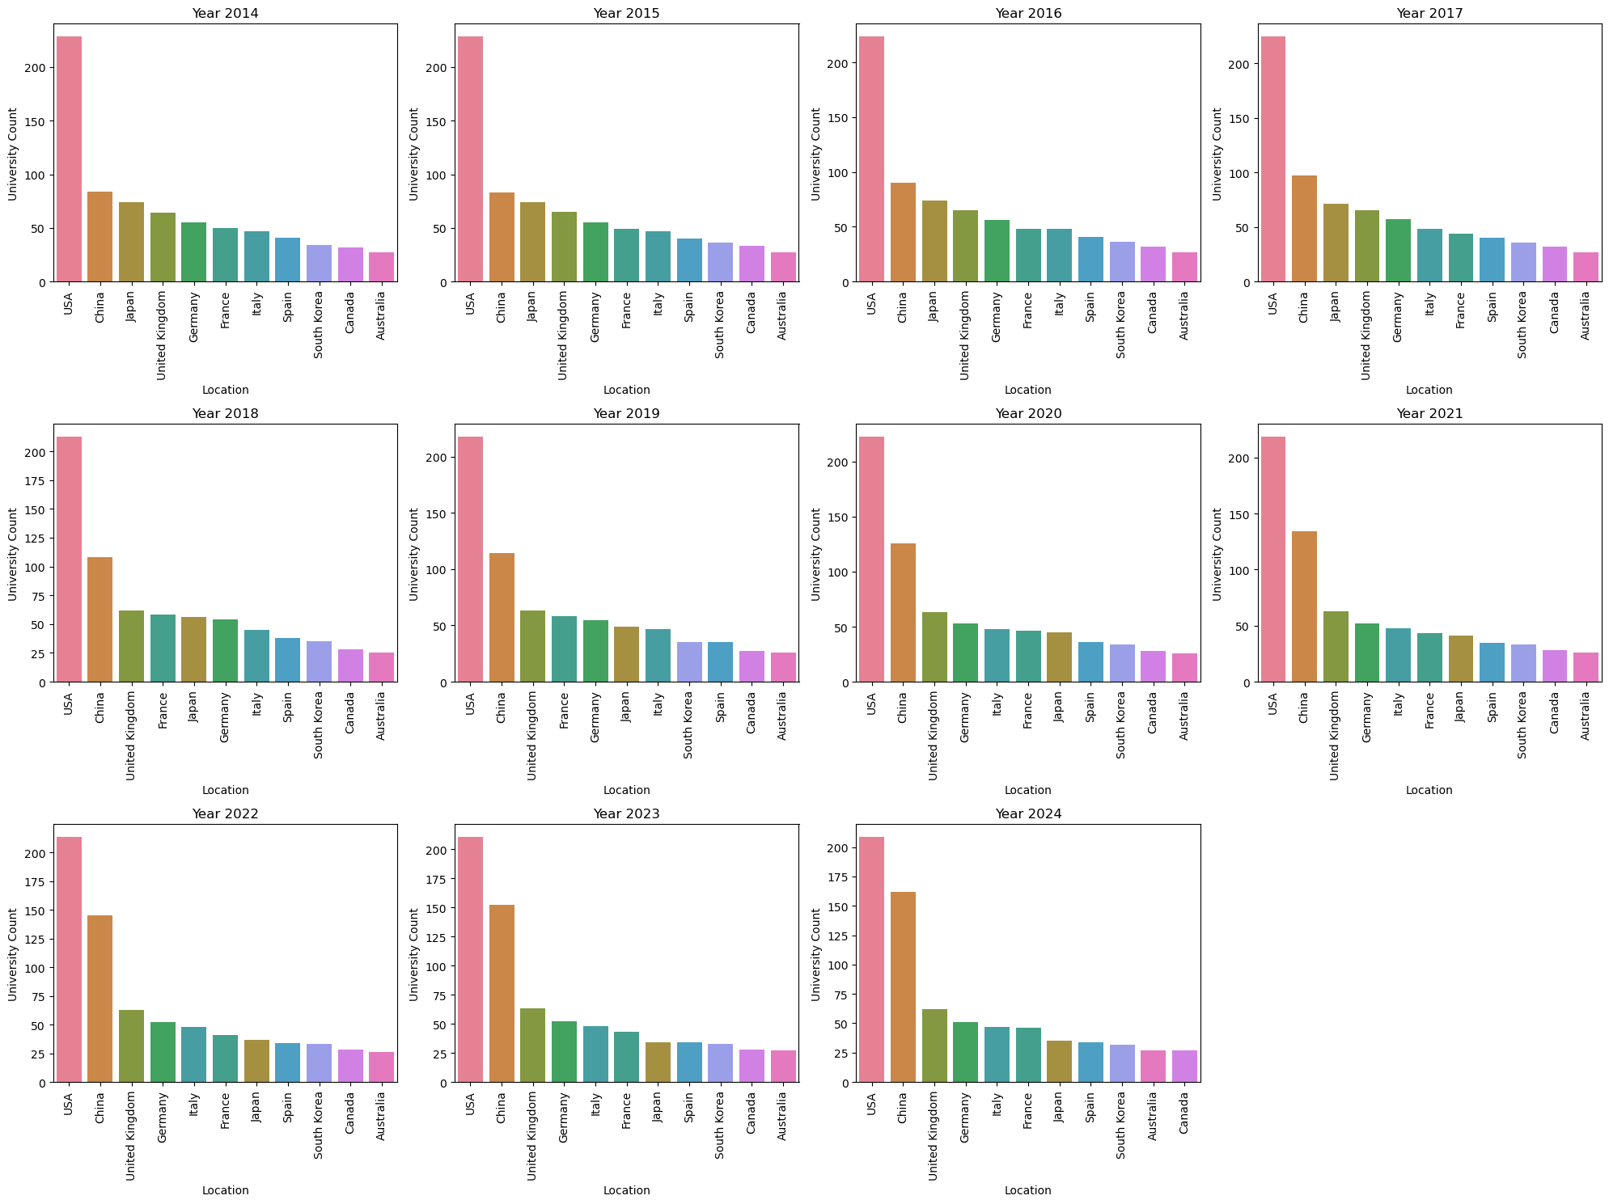
The top 9 universities stayed the same, with ranks shifting between 3rd and 9th over the years. Notable: Canada dropped out of the top 10 in 2024, while Australia, previously ranked 11th, entered the top 10 for the first time in a decade
Top 1000 University Counts in Top 11 Countries Over Year

Slide 11
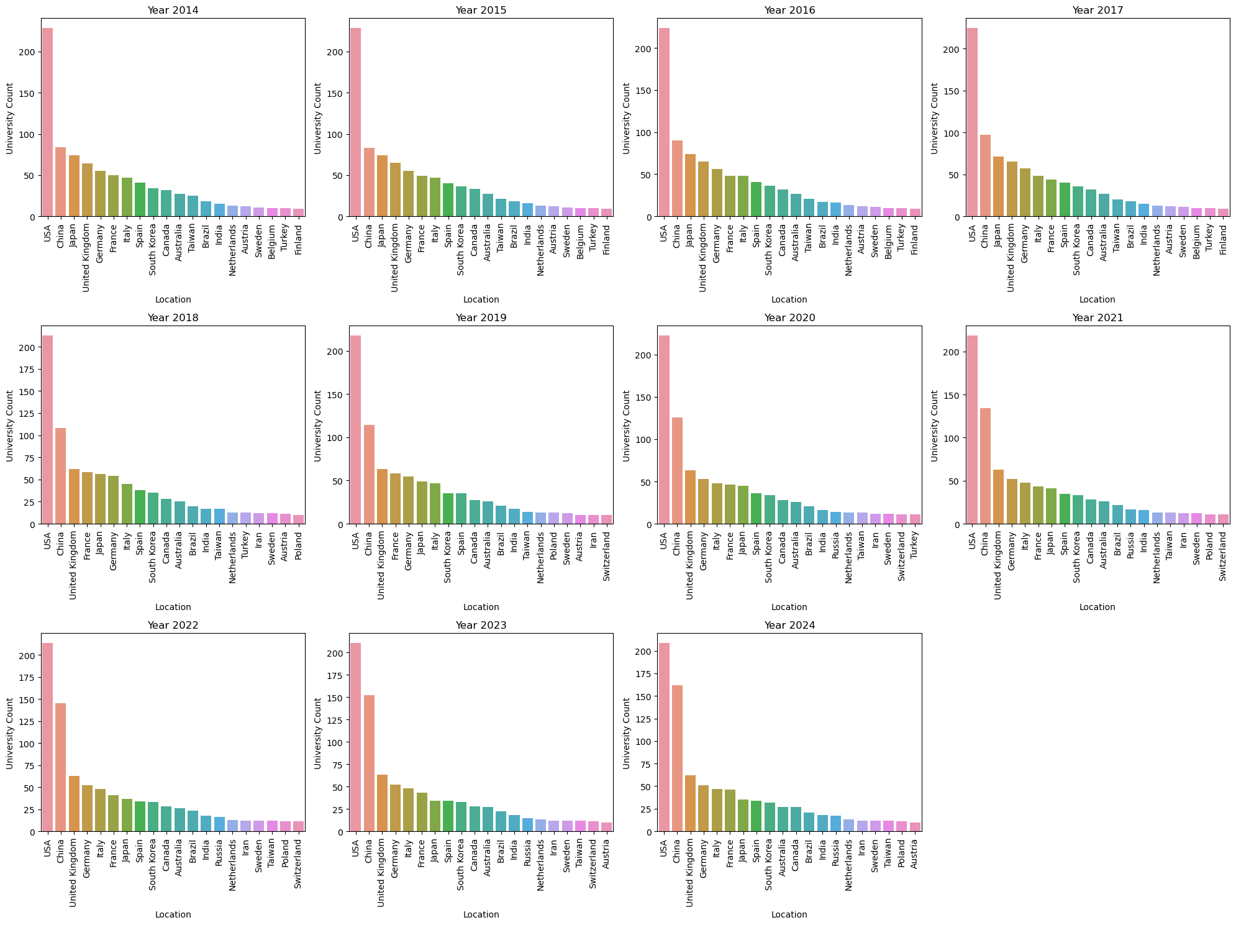
Iran entered the top 20 countries in 2018 and has stayed there since.
Top 1000 University Counts in Top 20 Countries Over Year

Slide 12
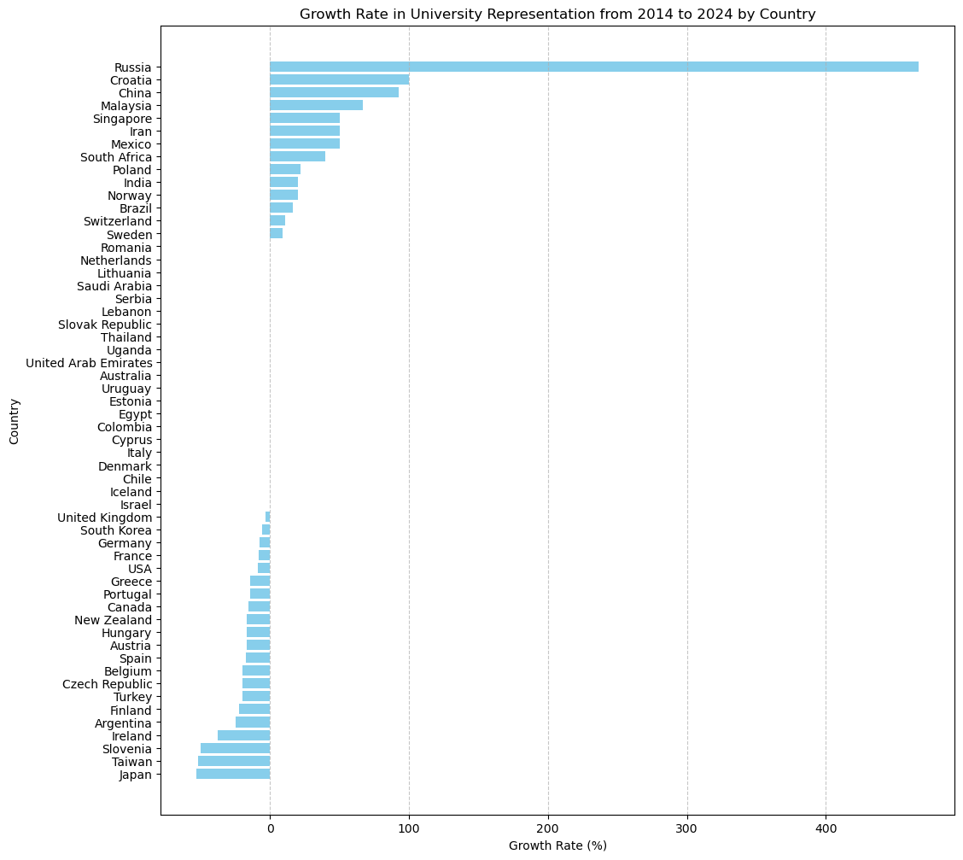
Russia leads with a remarkable 467% growth in university representation.
Croatia follows with 100% growth.
China, Malaysia, Singapore, and Iran also see strong gains in global rankings.
Japan, Taiwan, and Slovenia experience sharp declines

Slide 13
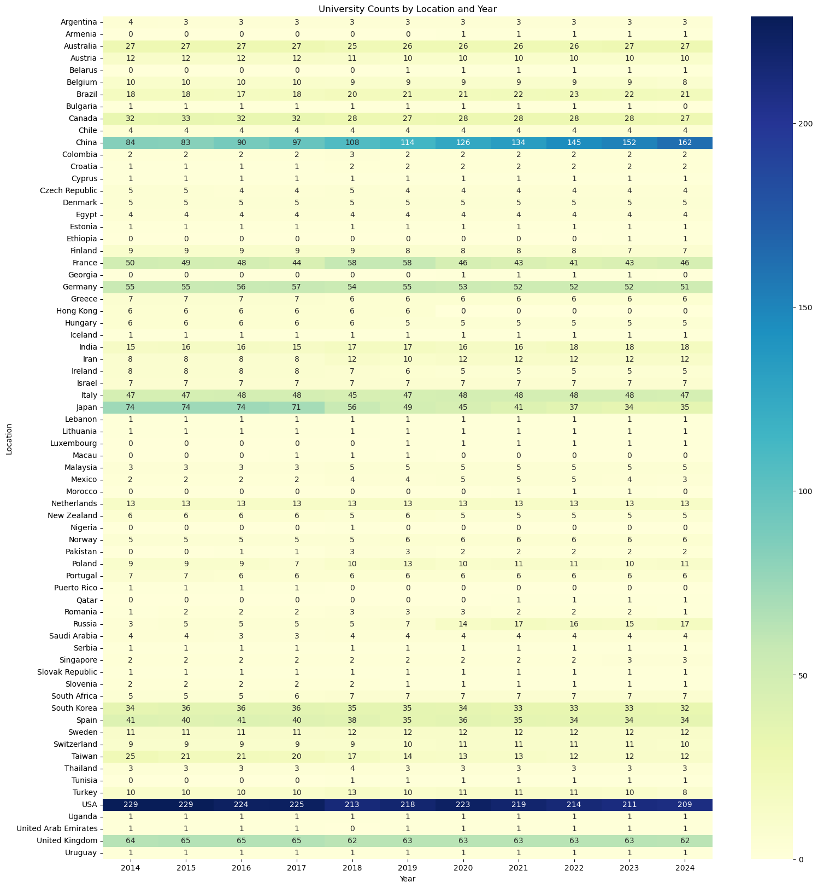
Table
confirms
the information of the previous slides.

Slide 14
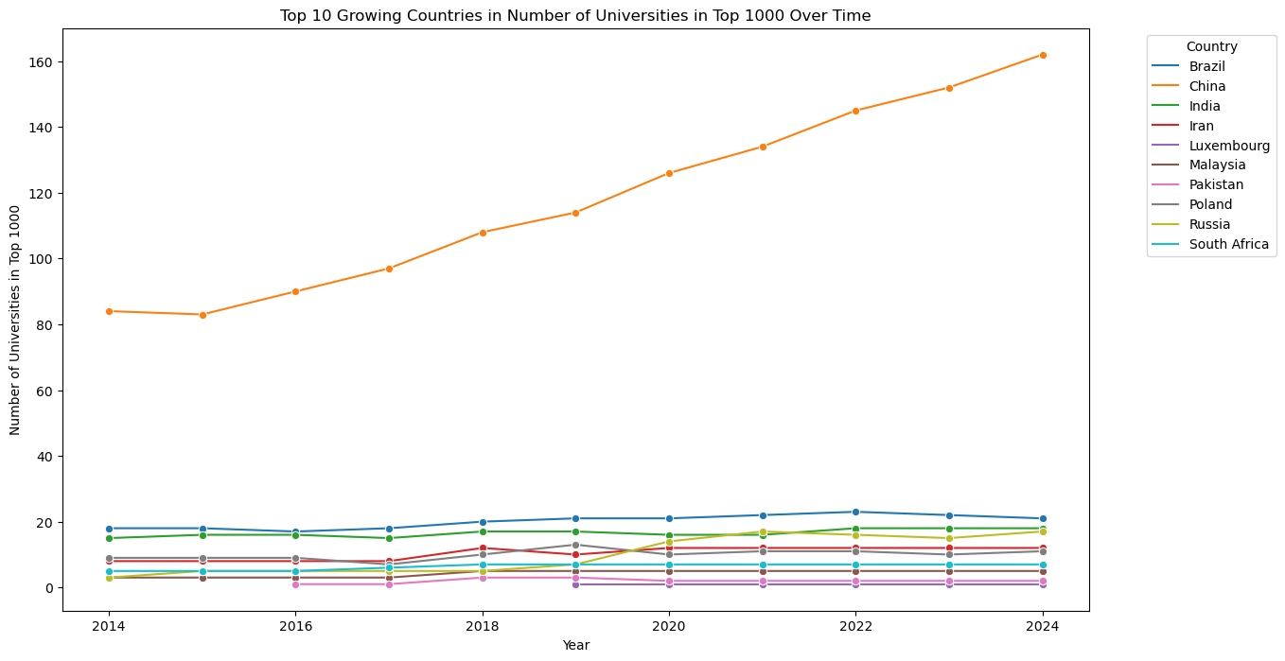
China shows a significant upward trend from 2014 to 2024
9 of 10 universities
are in the developing countries

Slide 15
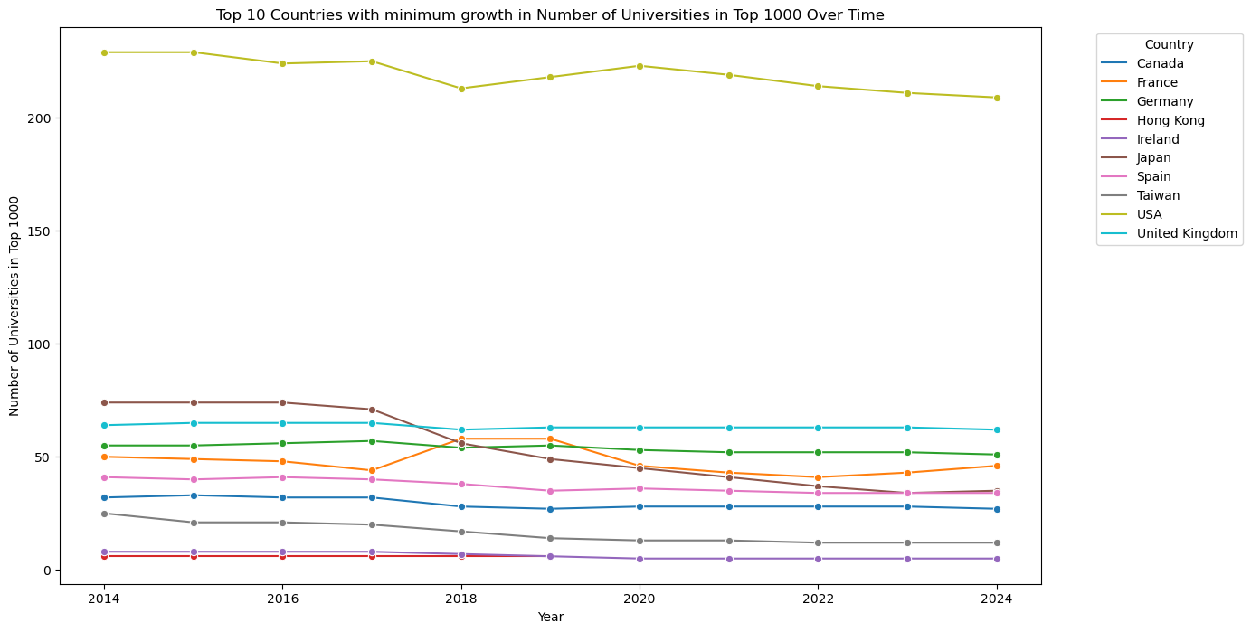
The USA
shows minimal growth.
Japan’s
decline and lack of growth
are evident.
All top universities are
in developed countries

Slide 16
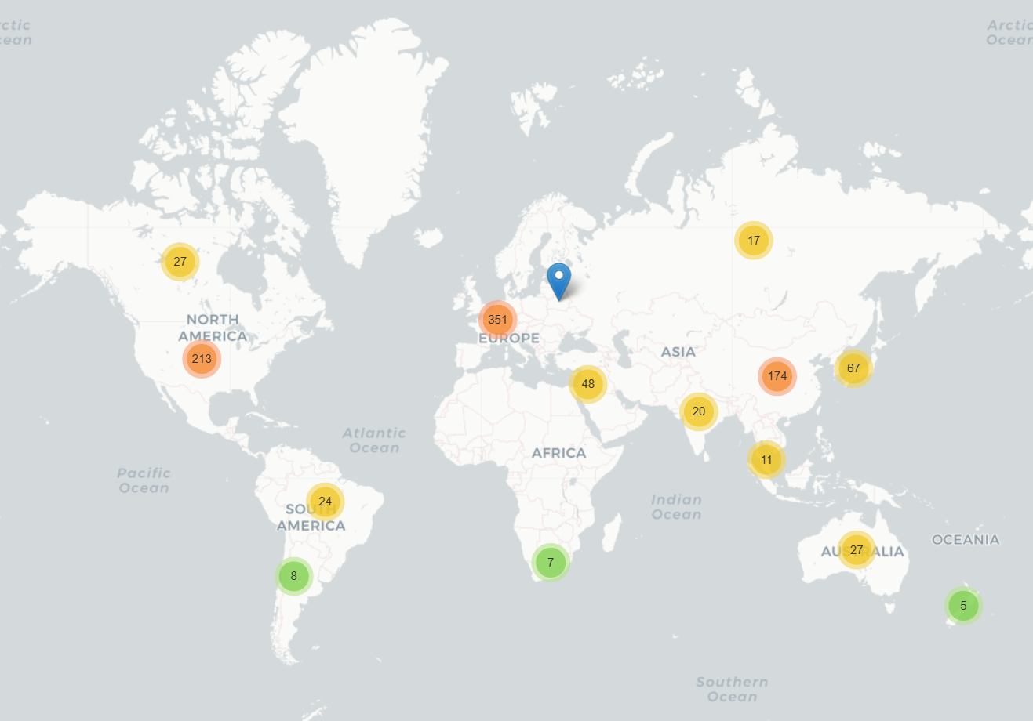
F:\00BBK\EDA\University\university_map.html

Slide 17
Conclusions
Research and Faculty Quality as Key Factors in Global University Rankings
Research and Faculty Quality Boost Global Rankings
Top Universities Lead in Research and Faculty
Employability and Education Play Smaller Roles in Rankings
Hypothesis :1- Research and employability ranks are the primary elements of global university rankings.
√ ×

Slide 18
Conclusions
Dynamic Shifts in Top University Rankings
Minimal changes in the top 5 university rankings.
Positions 6 to 20 Show Intense Competition.
Global Rankings Show Stability at the Top, Movement in Lower Ranks
√ Hypothesis : 2- The rankings of the world’s top universities are relatively stable and exhibit minimal change over time.

Slide 19
Conclusions
Developing Countries Bosst Growth in University Rankings
China, Malaysia, and Iran’s heavy investment in education drives their rise in global rankings, positioning them as leaders among developing nations.
Stability and Challenges for Developed Countries
The USA, UK, and Japan show stable rankings, though growth has slowed, with Japan experiencing a decline.
Regional Shifts: Growth and Decline
China’s rise contrasts sharply with declines in Japan and Taiwan, signaling a shift in regional academic influence.
√ Hypothesis : 3- Universities in developing countries, unlike those in developed countries, are showing an upward trend in global rankings.

Slide 20
Future Directions
Expand Ranking Analysis
Compare multiple ranking systems - THE (Times Higher Education World University Rankings), QS(Quacquarelli Symonds World University Rankings), ARWU(or Shanghai Rankings) - to uncover patterns, discrepancies, and provide deeper insights.
Economic and Institutional Factors
Explore how GDP(Gross domestic product) , education spending, and research funding affect rankings, and examine the performance of public vs. private and research vs. teaching universities.
University Type Matters: Public vs. Private and Research vs. Teaching Institutions
Analyze how different types of universities perform in global rankings. Public and research-focused institutions often have advantages in funding and research output, which may enhance their rankings, while teaching-focused and private institutions might excel in student satisfaction or employability metrics.
Regional and Cultural Influences
Investigate how language, history, and regional factors impact rankings, highlighting potential biases and advantages that shape global academic standings.

Slide 21

Thank you for your Attention
Eskerrik asko zure Arretagatik

